Slide 1
第6-3章: Clustering Analysis
Hierarchical clustering
Model-based clustering
References:
M. Eisen et al.: Cluster analysis and display of genome-wide expression patterns. Proc.Natl.Acad.Sci.USA 95, 14863-8, 1998
Wei Pan, Jizhen Lin and Chap T Le. Model-based cluster analysis of microarray gene-expression data. Genome Biology 3(2): research0009.1–0009.8, 2002.
G.J. McLachlan, R.W. Bean, and D. Peel, A Mixture Model-Based Approach to the Clustering of Microarray Expression Data. Bioinformatics 18, 413-422, 2002.

Slide 2




Eisen MB, Spellman PT, Brown PO, Botstein D. 1998. Cluster analysis and display of genome-wide expression patterns. PNAS 95: 14863-14868.
Google scholar citation: 13061 (04/25/2013), 13066(04/27/2013)

Slide 3

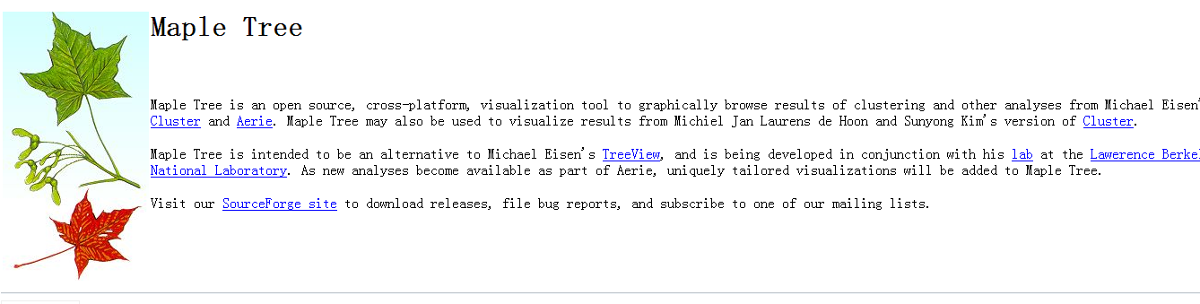
Cluster Analysis and Visualization Software
Cluster 3.0
http://bonsai.hgc.jp/~mdehoon/software/cluster/software.htm
TreeView
http://www.eisenlab.org/eisen/?page_id=42
http://mapletree.sourceforge.net/

Slide 4
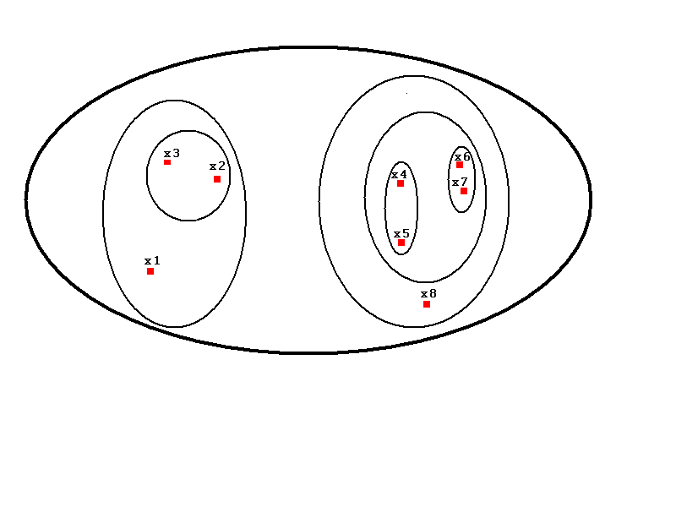
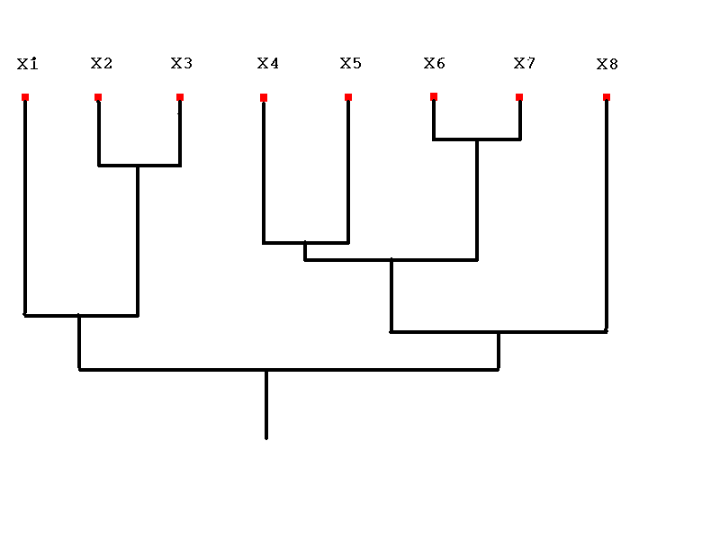
Hierarchical Clustering
Venn Diagram of Clustered Data
Dendrogram
From http://www.stat.unc.edu/postscript/papers/marron/Stat321FDA/RimaIzempresentation.ppt

Slide 5
Nearest Neighbor Algorithm
Nearest Neighbor Algorithm is an agglomerative approach (bottom-up).
Starts with n nodes (n is the size of our sample), merges the 2 most similar nodes at each step, and stops when the desired number of clusters is reached.
From http://www.stat.unc.edu/postscript/papers/marron/Stat321FDA/RimaIzempresentation.ppt

Slide 6
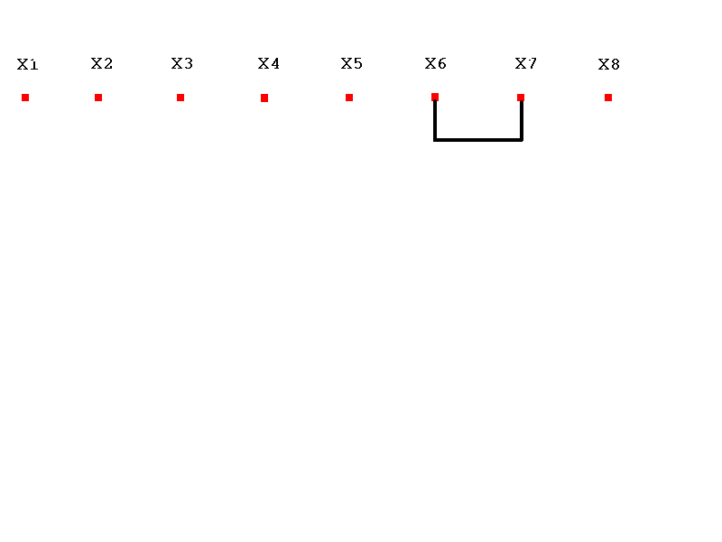
From http://www.stat.unc.edu/postscript/papers/marron/Stat321FDA/RimaIzempresentation.ppt

Slide 7
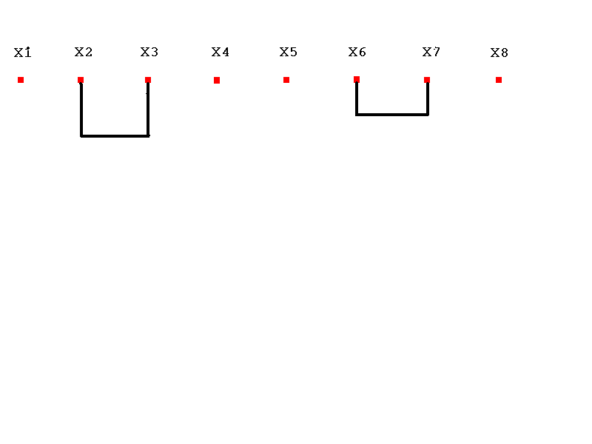

Slide 8
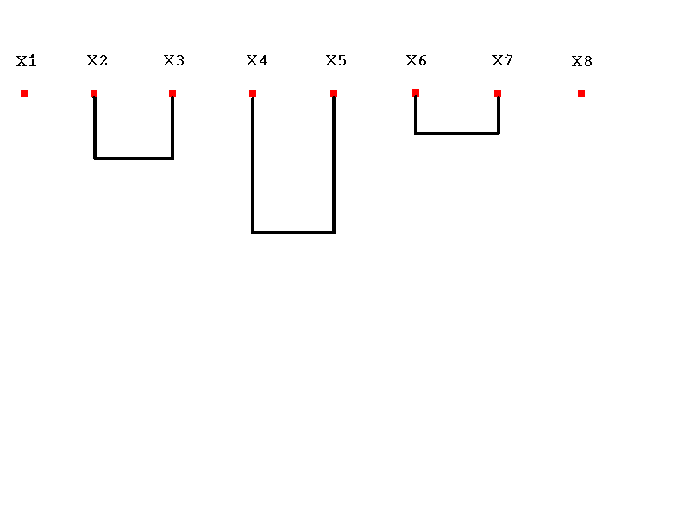

Slide 9
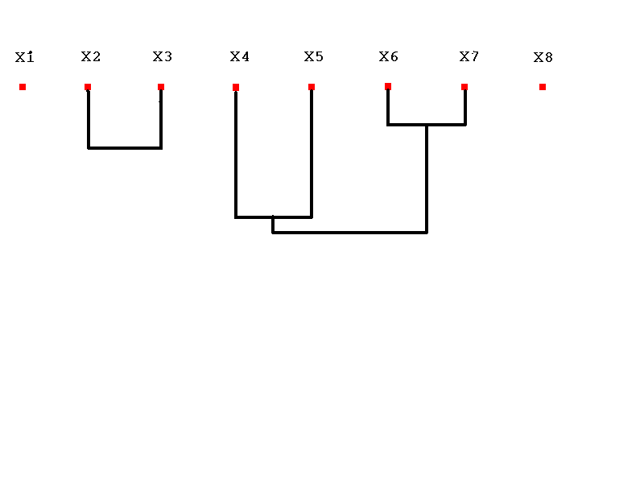

Slide 10
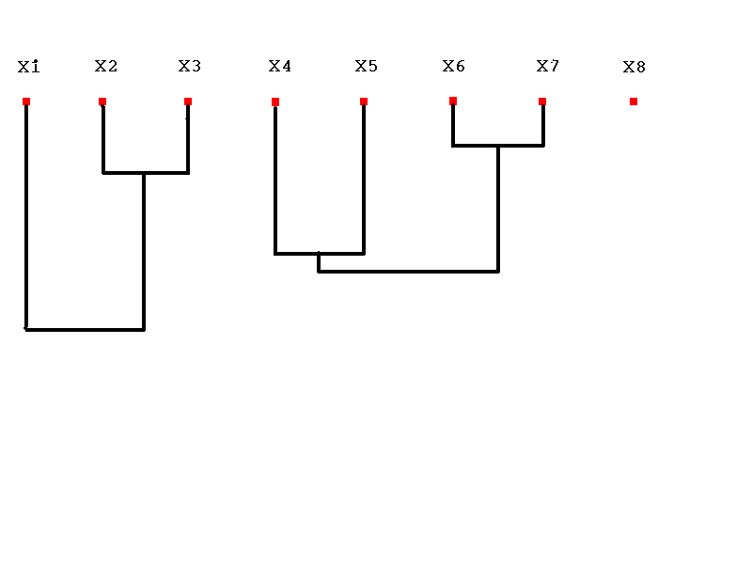

Slide 11
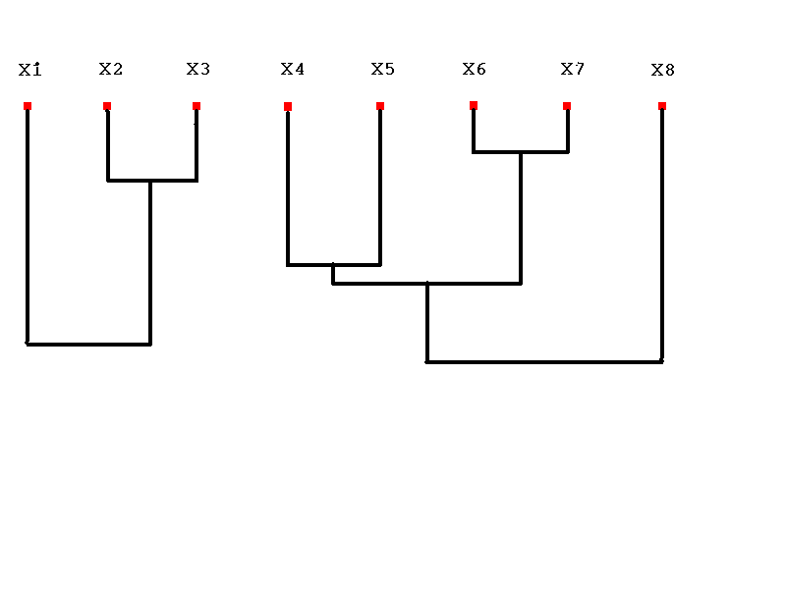

Slide 13
Similarity Measurements
Pearson Correlation
Two profiles (vectors)
and
+1 ≥ Pearson Correlation ≥ – 1

Slide 14
Similarity Measurements
Euclidean Distance

Slide 15
Similarity Measurements
Cosine Correlation
+1 ≥ Cosine Correlation ≥ – 1

Slide 16
Group Similarity
Single linkage
Complete linkage
Average linkage
Average group linkage

Slide 17
Clustering
Single Linkage
Dissimilarity between two clusters = Minimum dissimilarity between the members of two clusters
+
+
C₂
C₁
Tend to generate “long chains”

Slide 18
Clustering
Complete Linkage
Dissimilarity between two clusters = Maximum dissimilarity between the members of two clusters
+
+
C₂
C₁
Tend to generate “clumps”

Slide 19
Clustering
Average Linkage
Dissimilarity between two clusters = Averaged distances of all pairs of objects (one from each cluster).
+
+
C₂
C₁

Slide 20
Clustering
Average Group Linkage
Dissimilarity between two clusters = Distance between two cluster means.
+
+
C₂
C₁

Slide 21
Other Clustering Methods
K-means, fuzzy k-means
Self-organization mapping (SOM)
Gaussian mixture model, Bayesian clustering algorithms
Nonnegative Matrix factorization
Iterative signature algorithm (ISA), progressive iterative signature algorithm (PISA)…
Biclustering

Slide 22
K-means Algorithm
1. Choose K centroids at random
2. Make initial partition of objects into k clusters by assigning objects to closest centroid
Calculate the centroid (mean) of each of the k clusters.
a. For object i, calculate its distance to each of
the centroids.
b. Allocate object i to cluster with closest
centroid.
c. If object was reallocated, recalculate centroids based
on new clusters.
4. Repeat 3 for object i = 1,….N.
Repeat 3 and 4 until no reallocations occur.
Assess cluster structure for fit and stability

Slide 23
K-means Algorithm
Iteration = 0

Slide 24
K-means Algorithm
Iteration = 1

Slide 25
K-means Algorithm
Iteration = 2

Slide 26
K-means Algorithm
Iteration = 3

Slide 27
Gaussian Mixture Model
Each class corresponding to a normal distribution
The data point y is take to be a realization from a Gaussian mixture model

Slide 28
Learning the Parameters
Maximum likelihood estimation. Given data points
Missing data problem, the class label of each data point.

Slide 29
EM Algorithm
Iteratively update

Slide 30
Choose the Number of Clusters
Akaike Information Criterion (AIC)
Bayesian Information Criterion (BIC)
where v_{g} is the number of independent parameters
Akaike H: Information theory and an extension of the maximum likelihood principle. In 2nd Int Symp Information Theory. Edited by Petrov BN, Csaki F. Budapest: Akademiai Kiado,1973, 267-281.
Schwartz G: Estimating the dimensions of a model. Annls Statistics 1978, 6:461-464.

